Slide 1
Sampling Distributions
Shovan Bhowmik
Lecturer
Dept. of Cse, Baiust

Slide 2
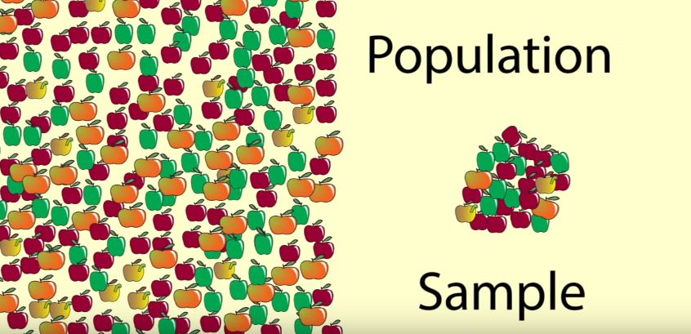
Statistical Inference
The process of drawing conclusions about population parameters based on a sample taken from the population.
Population and Sample:
Sample Mean = 149g
Population Mean = 149g

Slide 3
Statistical Inference(Cont..)
A sample is likely to be a good representation of the population.
There is a element of uncertainty as to how well the sample represents the population.
The way the sample is taken matters.
Statistical inference is basically concerned with generalizations and predictions.
A statistic is a random variable that depends only on the observed sample.
It must have a probability distribution.

Slide 4
Sampling Distribution
The probability distribution of a statistic is called a sampling distribution.
Depends on:
Distribution of the population
Size of the samples
Method of choosing the samples
Distribution Categories:
Normal Distribution
Chi – Squared Distribution
t - Distribution

Slide 5
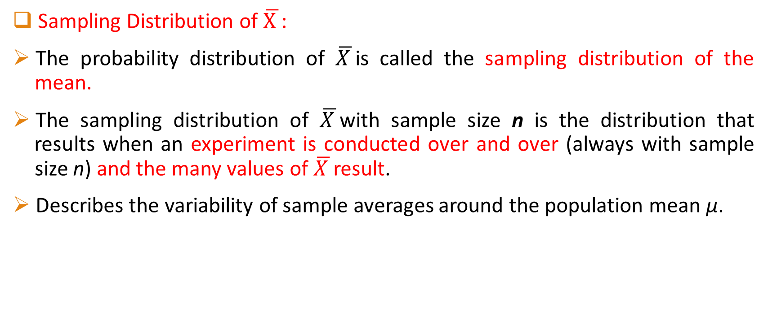
Normal Distribution of Samples
Sampling Distribution of $\overline{X }$:
The probability distribution of $\overline{X }$is called the sampling distribution of the mean.
The sampling distribution of $\overline{X }$with sample size n is the distribution that results when an experiment is conducted over and over (always with sample size n) and the many values of $\overline{X }$result.
Describes the variability of sample averages around the population mean μ.

Slide 6
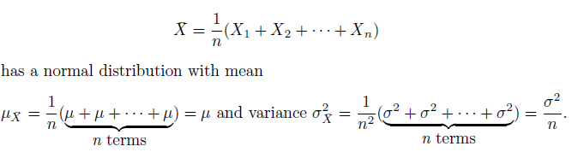

Normal Distribution of Samples(Cont..)
Sampling Distribution of $\overline{X }$(Cont..) :
a random sample of n observations
mean μ
variance σ²

Slide 7
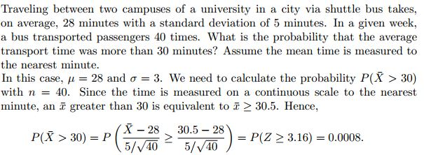
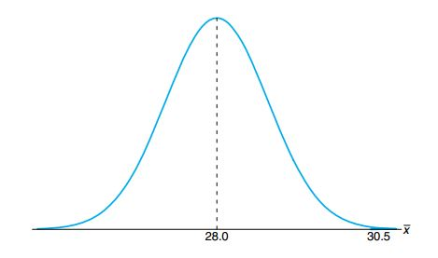
Normal Distribution of Samples(Cont..)
Central Limit Theorem has been covered previously.
Example:

Slide 8
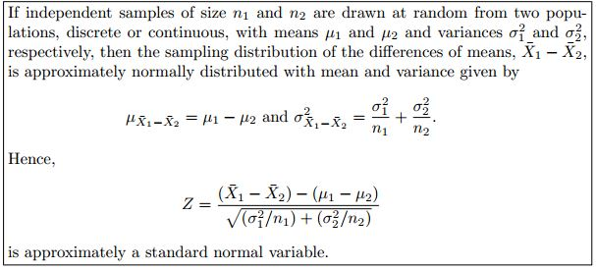
Normal Distribution of Samples(Cont..)
Central Limit Theorem for two samples:

Slide 9
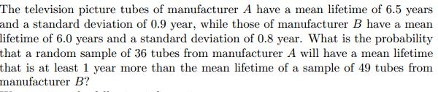



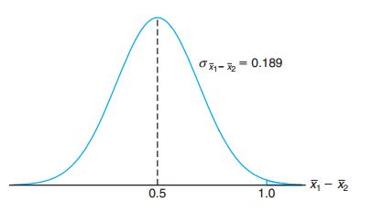

Normal Distribution of Samples(Cont..)

Slide 10
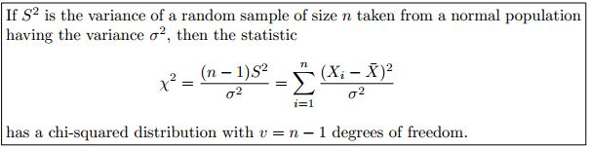
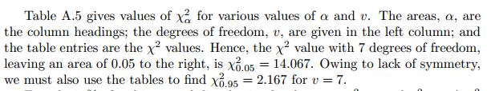
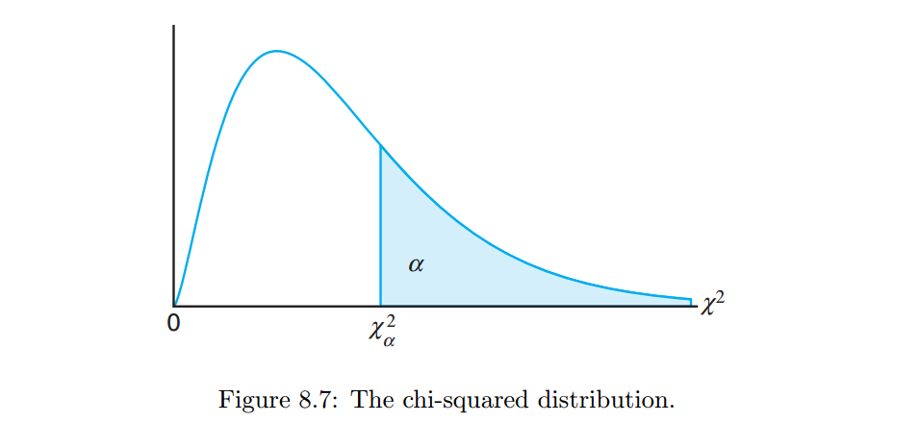
Chi - Squared Distribution of Samples

Slide 11
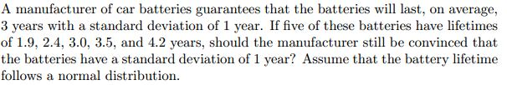
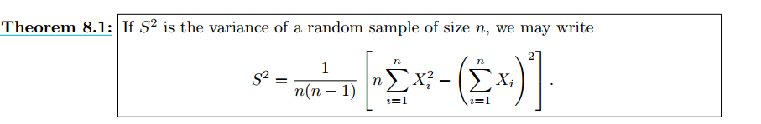

Chi - Squared Distribution of Samples(Cont..)
Exactly 95% of a chi-squared distribution lies between ${ \text{χ}}_{0.975}^{2}$and ${\text{χ}}_{0.025}^{2}$.
Example 1:

Slide 12
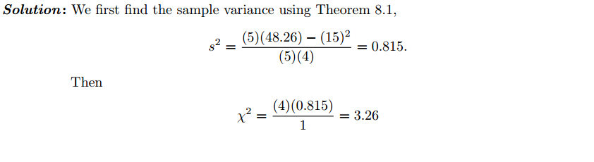
Chi - Squared Distribution of Samples(Cont..)
Example 1(Cont..):
Since 95% of the χ2 values with 4 degrees of freedom fall between 0.484 and 11.143, the computed value with σ2 = 1 is reasonable, and therefore the manufacturer has no reason to suspect that the standard deviation is other than 1 year.

Slide 13
Chi - Squared Distribution of Samples(Cont..)
Example 2: Assume the sample variances to be continuous measurements. Find the probability that a random sample of 25 observations, from a normal population with variance σ² = 6, will have a sample variance S²
(a) greater than 9.1
(b) between 3.462 and 10.745
Solution:
a) P(S² > 9.1) = P( > ) = P(χ² > 36.4) = 0.05
b) P(3.462 < S² < 10.745) = P( < < ) =
0.95 – 0.01 = 0.94

Slide 14

t - Distribution of Samples
t – distribution formula is :
S is the standard daviation of samples. It varies from sample to sample.
Here DF = n – 1
As the degrees of freedom increase, t-distribution tends toward the standard normal distribution.
If n ≥ 30, the distribution of T does not differ considerably from the standard normal distribution.

Slide 15
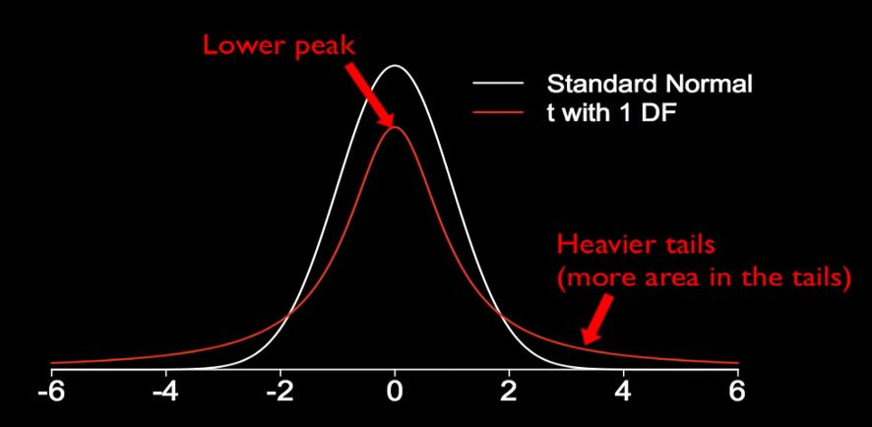
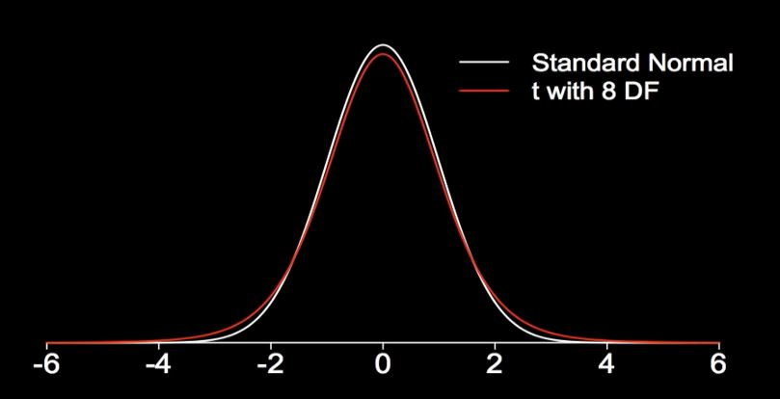
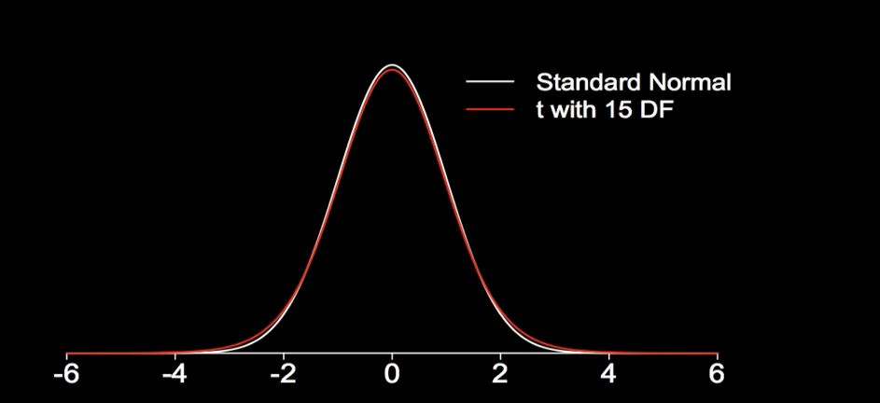
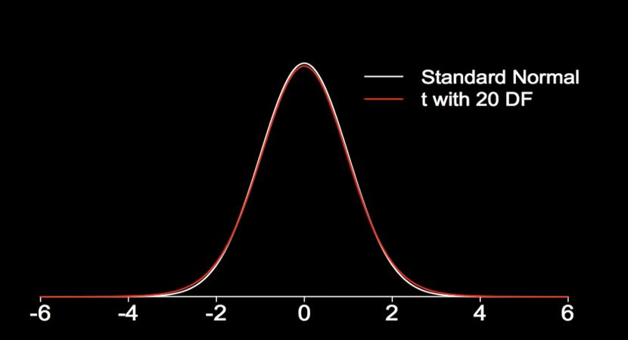
t - Distribution of Samples(Cont..)

Slide 16
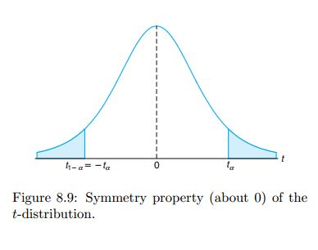
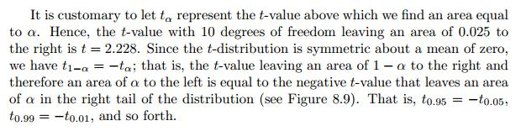
t - Distribution of Samples(Cont..)

Slide 17
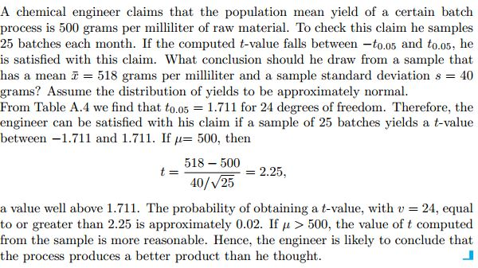
t - Distribution of Samples(Cont..)
Example:

Slide 18
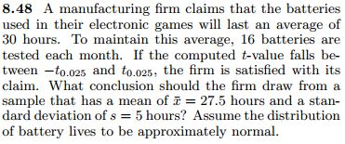
t - Distribution of Samples(Cont..)
Do it yourself

Slide 19
Math Problems needed to solve
Walpole Book:
Examples: 8.5, 8.6, 8.7, 8.9, 8.11
Exercises: 8.18, 8.22, 8.23, 8.30, 8.32, 8.37, 8.38, 8.43, 8.45, 8.49
Slide Math

Slide 20
References
Probability and Statistics for Engineers and Scientists(9th Edition) – Walpole
https://www.youtube.com/watch?v=B9u_grPccUs
https://www.youtube.com/watch?v=Uv6nGIgZMVw
https://www.youtube.com/watch?v=dXB3cUGnaxQ
Internet Sources

Slide 21


